Slide 1


KisanBandhu: AI Crop Guide

Slide 2


Contents
01
02
03
Project Vision
Smart Core
Friendly Features
04
05
06
Clear Workflow
Expected Impact
Next Steps

Slide 3

01
Project Vision

Slide 4
KisanBandhu
Your AI Crop Friend
A free mobile app that acts like a trusted friend for every farmer. It listens to soil, weather, and market signals, then speaks the farmer’s language to suggest the most profitable crop for each plot.
Boosts Income
Saves Time & Resources

Slide 5
Real Problem, Simple Solution
Delivered through voice in Hindi, Tamil, Marathi and more.
Millions of small farmers guess what to sow and lose money when the guess is wrong. KisanBandhu removes the guesswork by turning farm data into clear crop advice.
Works fully offline, so no farmer is left behind.

Slide 6
02
Smart Core

Slide 7
AI Brain Inside the App
The app trains multiple AI learners on years of data. Together, they vote for the crop with the highest profit chance and lowest risk for the farmer's exact field.
+
+
+
Random Forest
Neural Net
Decision Tree
Logistic Reg.

Slide 8

Data That Powers Decisions
Five easy numbers collected with cheap kits or government labs are enough. GPS adds local weather and mandi prices. No complex sensors, no extra cost.
Soil pH
Nitrogen (N), Phosphorus (P), Potash (K)
Moisture
GPS for local context

Slide 9
03
Friendly Features

Slide 10

Talk in Your Language
A built-in voice chatbot asks simple questions and replies in the farmer’s chosen language. Speech input removes typing and literacy barriers.
Voice-based interaction
Hindi, Tamil, Marathi & more
Works fully offline after first install

Slide 11
Offline First, Cloud Optional
Once models download, the app needs no internet. Farmers capture soil data, get crop names, expected yield, and best sowing week. Sync uploads results when connectivity returns.
Farmer's Phone
Sync When Online
Offline Data Collection
Improves AI for Everyone

Slide 12
04
Clear Workflow

Slide 13
Three-Step Journey to Profit
1
3
2
Capture Data
Get Advice
Farmer opens app, taps microphone, answers five simple questions about their field.
AI Analysis
App speaks the top three crops, expected profit per acre, and required inputs.
AI compares field data to millions of past outcomes in seconds to find the best options.

Slide 14
1. Farmer Acts
Sows recommended crop
4. Smarter Advice
2. Feedback Loop
Sharper recommendations
Reports actual yield & price
3. AI Learns
System retrains nightly

Slide 15
05
Expected Impact

Slide 16
Income Up, Risk Down
15-25%
30%
Higher Profit
Less Seed Waste
20%
Water & Fertilizer Savings
Lower Risk

Slide 17
Component | Technology
Frontend | React Native
Backend | Node.js / Django REST
Database | Firebase / MongoDB/ MySQL
ML Model | Python (Scikit-learn, TensorFlow)
APIs | SoilGrids, OpenWeatherMap, Agmarknet
AI Chatbot | Generative AI (GPT API / Gemini)
Hosting | Vercel/Netlify

Slide 18

Scalable & Sustainable
Built on open-source tools and lightweight models under 50 MB, KisanBandhu runs on basic Android phones common in rural India. Government Krishi Vigyan Kendras can freely integrate it.
Runs on basic Android phones
Lightweight (< 50 MB)
Free integration for KVKs

Slide 19
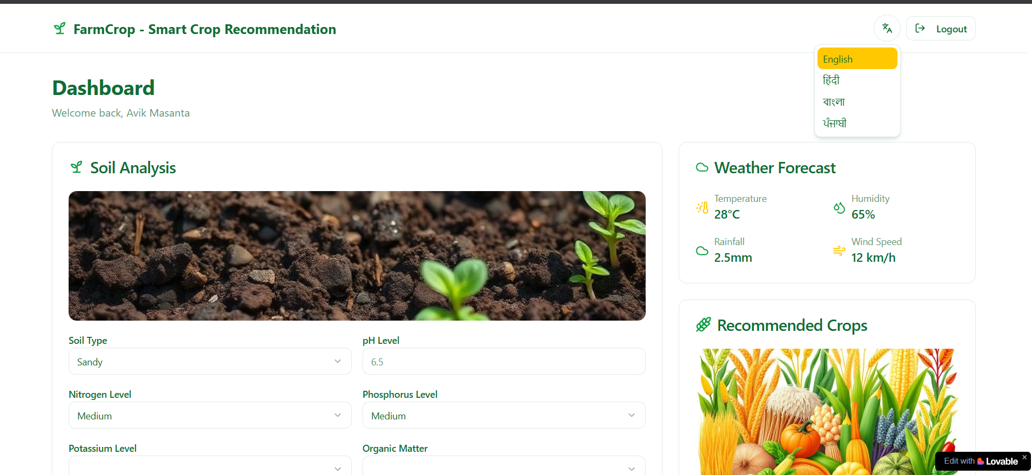
Website UI

Slide 20
07
DFD

Slide 21
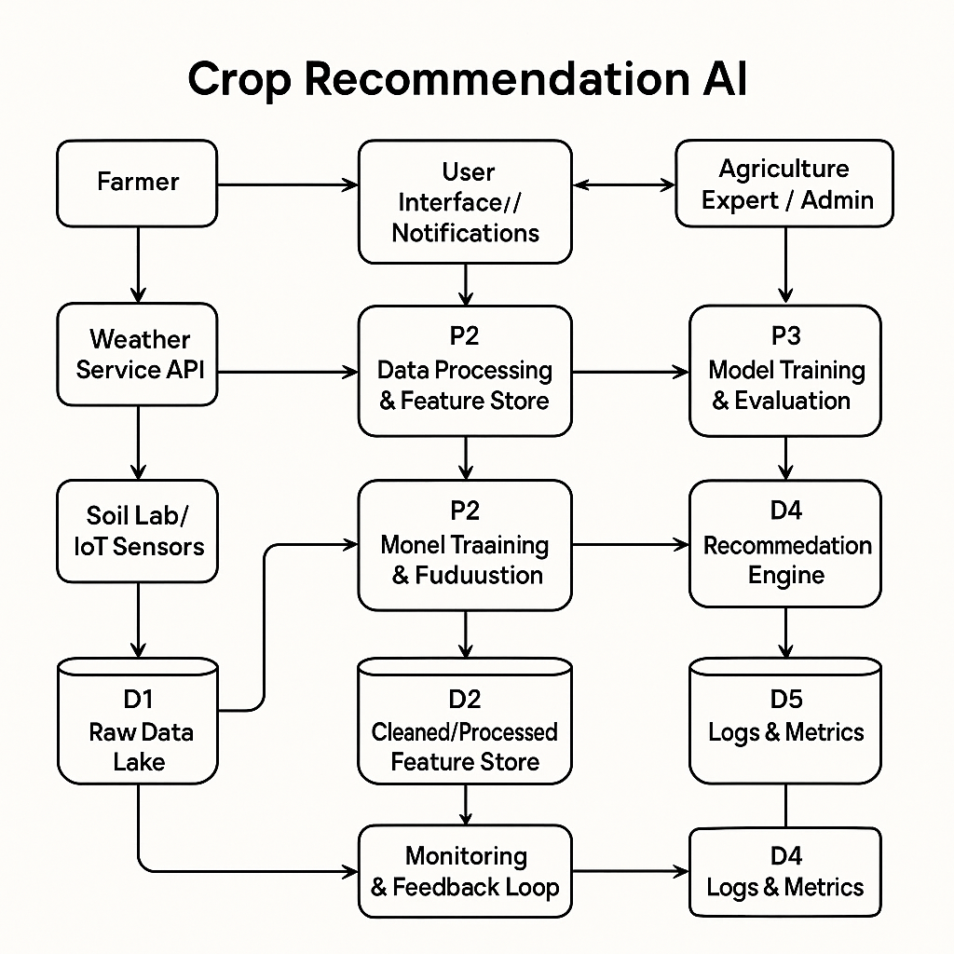

Slide 22
06
Next Steps

Slide 23
Pilot, Partner, Expand
1. Pilot
2. Partner
3. Expand
Test with 500 farmers in two zones.
Collaborate with state Agri Depts & FPOs.
Statewide roll-out with added features.

Slide 24


THANK YOU

